Slide 1
Google BigQuery
Johannes Ahlmann
johannes@sensatus.io

Slide 2
Why?
What is BigQuery, Dremel
Use cases (large data), example datasets
How does it compare to XXX
Data Sources, Data Formats
Data Sinks (google sheets, ODBC, pandas, data studio, etc.)
BigQuery ML?

Slide 3





Data Formats

Slide 4
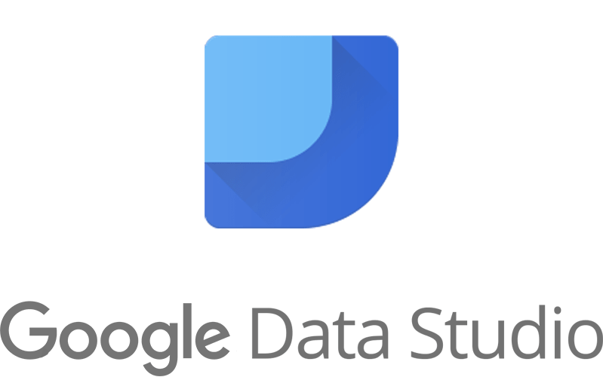




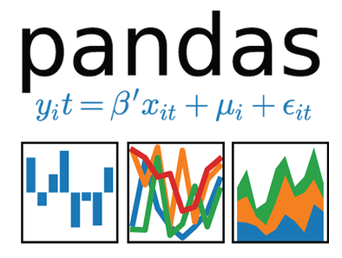


Data Sources
Google
Cloud Storage

Slide 5
Sample Datasets
bigquery-public-data:
crypto_bitcoin (1.1TB)
crypto_ethereum (1.4TB)
github_repos (3.7TB source code)
fh-bigquery:
wikipedia_v3 (11TB pageviews)
reddit_comments (1.8TB)
reddit_extracts (5.6TB)
wikidata (3.5TB)
pypi (20TB package installs)
stackoverflow (5.2TB)
stackoverflow_archive (2TB)
wikidata (3.5TB)
SELECT sum(size_bytes)/pow(10,12) as size
FROM `<dataset>.__TABLES__`;
gdelt-bq:gdeltv2 (79TB)
githubarchive:day (6TB)
httparchive:latest (27.5TB)

Slide 6
Dremel: Interactive Analysis of Web-Scale Datasets
inspiration for Apache Drill, Apache Impala
Columnar
Query Execution
Interactive ad-hoc query system for in-situ nested data, near-realtime
Strongly-typed nested records
MR ~ minutes to hours, Dremel ~ seconds
storage (active - changed within 90 days, long-term older than 90 days)

Slide 7
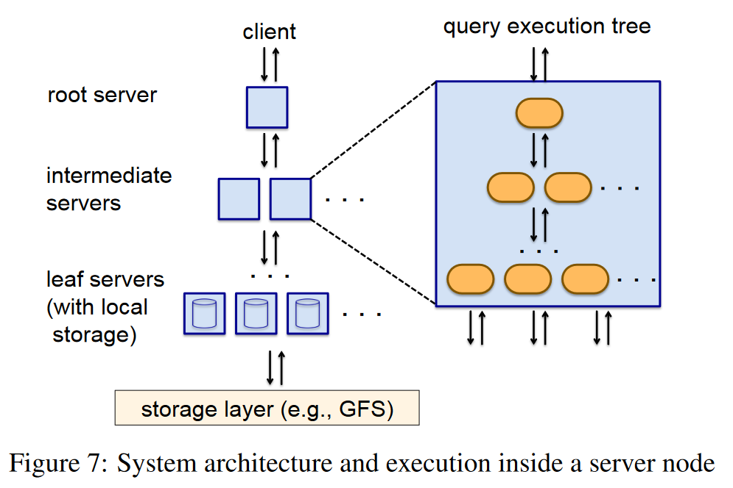
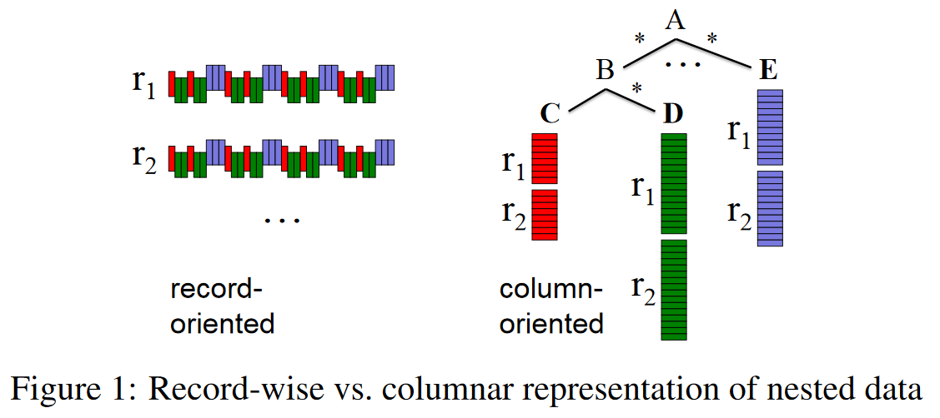
Query Execution

Slide 8
Athena
from S3
results within seconds
SQL
pay-per-query ($5/ tb) + s3 storage cost ($0.023/ GB)
no UDF
more partitioning (vs. date-based only; BQ now also supports clustering)
results stored in s3
uses Hive to create tables
uses Presto for queries
built for running queries on smaller, single data source
columnar??
https://chartio.com/resources/tutorials/bigquery-vs-athena/
https://medium.com/cloudwithmore/aws-athena-vs-google-bigquery-81a5e885d5c6

Slide 9
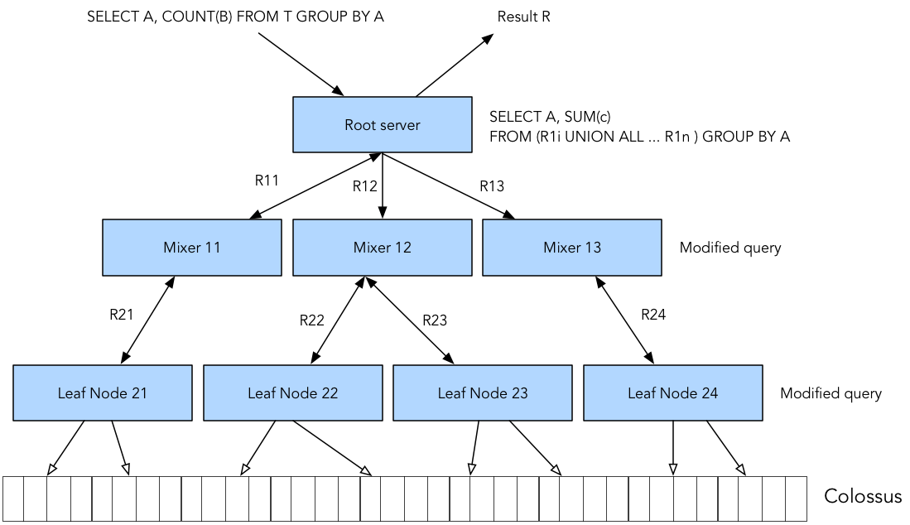
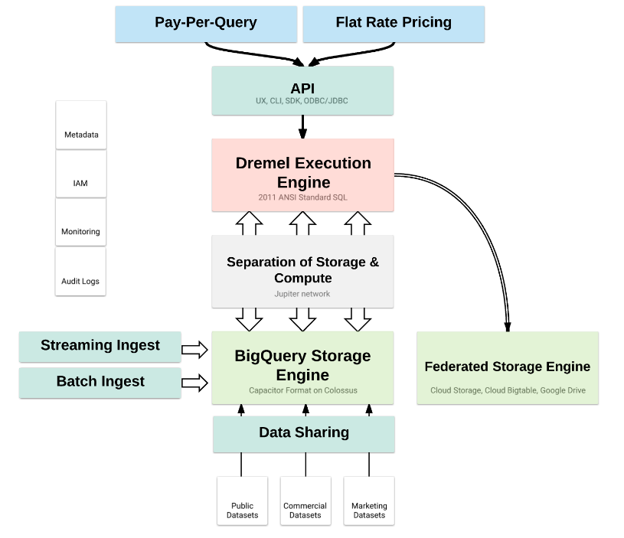
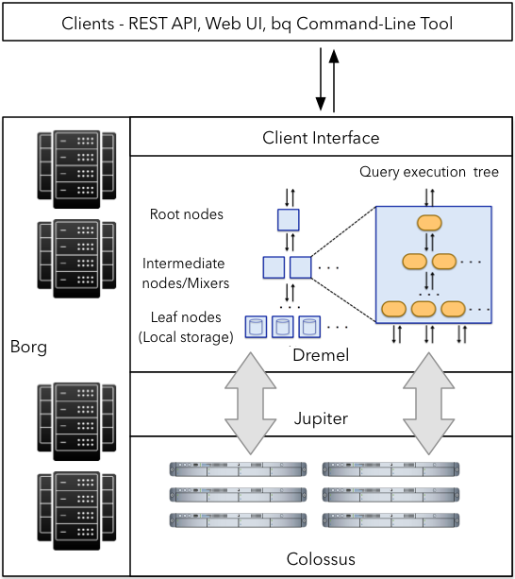
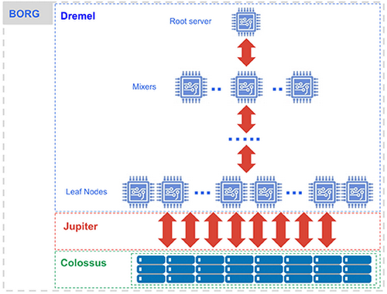
Architecture

Slide 10
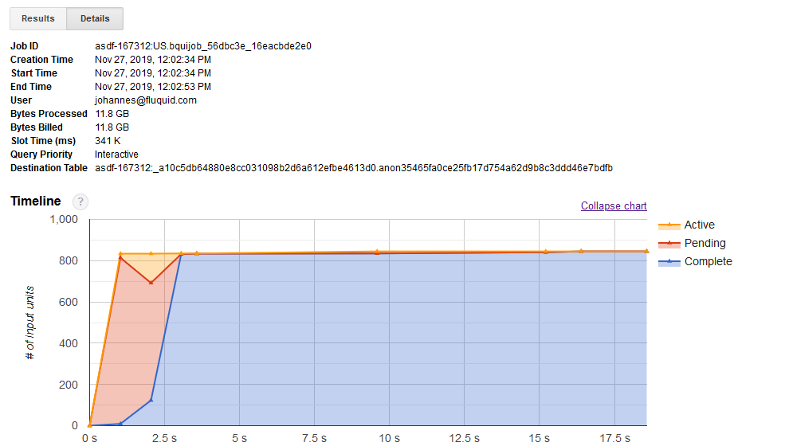

Slide 11






Alternatives
Postgres
Presto

